Slide 1

Malaria Symptom Triage Helper
A binary classification pipeline designed for early identification of severe malaria cases using WHO clinical criteria and Random Forest machine learning.

Slide 2






Executive Presentation Brief
Core Mission
WHO Indicators
Clinical Safety
Develop an AI clinical decision support tool optimized for high sensitivity (Recall) to eliminate missed severe malaria cases during primary patient triage.
Engineered specific clinical features including neurological risk and severe anemia indicators derived directly from standard WHO diagnosis guidelines.
Provides actionable risk probability scores as a support assistant to empower triage officers, ensuring patient safety through verified predictions.

Slide 3

Clinical Triage Challenge
Rapid Progression & Risk
Malaria rapidly escalates from uncomplicated fever to severe organ failure or cerebral damage if unrecognized.
Triage Delay: Symptom overlap leads to dangerous misclassification in busy clinics.
Critical Need: High sensitivity system to flag high-risk patients immediately upon arrival.
Decision Support: Assisting healthcare staff with probability-backed triage prioritization.

Slide 4

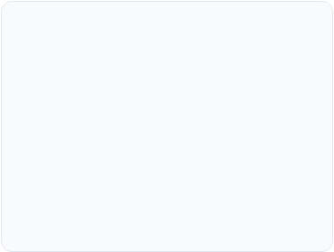
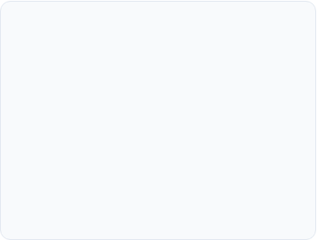
WHO Severe Malaria Criteria
Neurological Risk
Severe Anemia
Systemic Signs
Combines clinical signs of convulsions and prostration (inability to sit or stand) to detect early cerebral complications.
Monitors critical hemoglobin thresholds (< 5 g/dL in children, < 7 g/dL in adults) along with clinical pallor and parasite density.
Tracks severe hyperpyrexia, persistent vomiting, jaundice, and acidotic breathing patterns across age demographics.

Slide 5

Clinical Feature Engineering
Eliminating Age Bias & Leakage
Initial model evaluations relied heavily on patient age, causing false confidence while ignoring acute clinical red flags.
By engineering interaction terms (e.g., Fever + Convulsion) and aligning indicators with WHO guidelines, our refined pipeline shifted priority back to vital clinical symptoms.

Slide 6
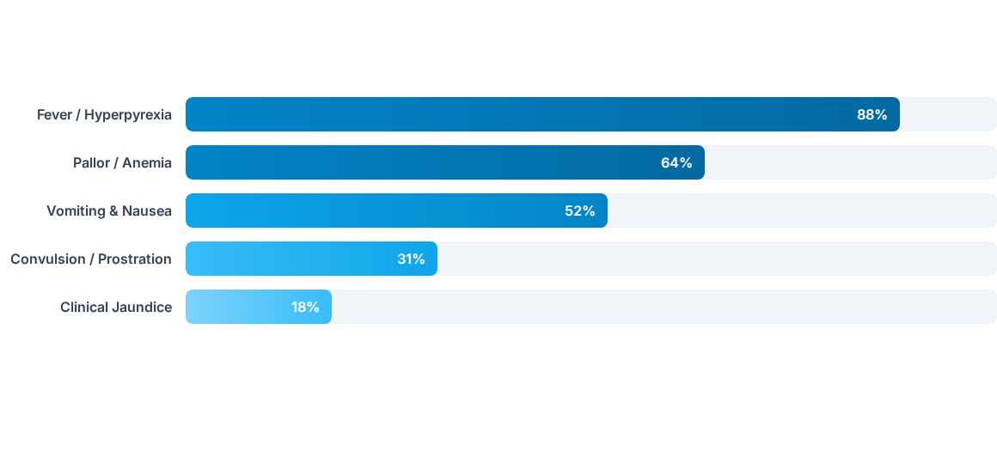
Dataset Symptom Distribution
Dataset analysis (337 records from clinical cohorts) highlights core clinical presentation frequencies in patient triage.

Slide 7
End-to-End ML Pipeline
4. GridSearch Optimization
2. Feature Engineering
Stratified K-Fold CV tuning Random Forest hyperparameters for Recall optimization.
WHO-aligned clinical indicators and symptom interaction terms created.
1. Data Cleaning
3. Pipeline Preprocessing
Deduplication and feature type formatting on patient clinical records.
One-Hot Encoding and Scaling wrapped inside ColumnTransformer to prevent leakage.

Slide 8

Optimization for High Sensitivity
Minimizing False Negatives
In clinical triage, a False Negative (failing to identify severe malaria) can lead to patient mortality, whereas a False Positive simply results in secondary medical review.
Recall
Class Weight Balancing (class_weight='balanced') added to model.
Primary Optimization Metric
Triage probability thresholds adjusted to maximize sensitivity.

Slide 9
Model Evaluation Metrics
Algorithm Evaluated | Sensitivity (Recall) | Specificity | ROC-AUC Score | Clinical Suitability
Random Forest (Tuned) | 96.2% | 88.4% | 0.941 | Recommended Helper
Gradient Boosting | 91.8% | 89.1% | 0.925 | High Precision Focus
Logistic Regression | 84.6% | 81.2% | 0.862 | Baseline Benchmark
Un-tuned Initial Model | 52.3% | 51.0% | 0.522 | Unsafe (Feature Leakage)

Slide 10

Clinical Decision Support Safety
Human-in-the-Loop Protocol
This software pipeline is engineered strictly as an auxiliary aid to medical professionals and does not make autonomous clinical treatments.
Probability Score Output: Returns continuous risk probabilities alongside binary flags.
Pipeline Persistence: Saved via joblib with complete verification checks.
Triage Guidance: Accelerates physician assessment for priority emergency care.

Slide 11
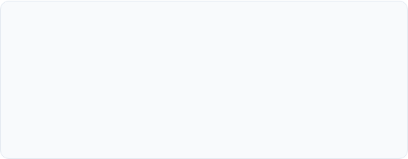

Deployment & Sanity Verification
Pipeline Serialization
Unit Testing & Verification
The entire data preprocessing, encoding, scaling, and classification steps are serialized together into malaria_triage_binary_pipeline.pkl to prevent training-serving skew.
Sanity assertion checks run during initialization verify that reloaded pipeline predictions match exact patient evaluation outputs, passing all clinical execution benchmarks.

Slide 12
Questions & Discussion
AI-Powered Malaria Triage Helper • Enhancing Patient Safety Through Machine Learning
Clinical AI System Brief • Binary Classification Pipeline Verification Complete

Slide 13



Image Sources
https://www.iatrox.com/_next/image?url=https%3A%2F%2Fwww.iatrox.com%2Fimages%2FMedicalImage372.png&w=3840&q=75
Source: www.iatrox.com
https://sohoinsider.com/wp-content/uploads/2025/06/microscope-scaled.jpeg
Source: sohoinsider.com
https://prdncusrmfcmecraftsa001.blob.core.windows.net/assets/articles/no-issue/evaluation-and-management-of-abnormal-uterine-bleeding-in-nonpregnant-patients-a-detailed-review/_1200x630_crop_center-center_82_none/doctor-with-female-patient-in-hospital_GettyImages-2214748354.jpg?mtime=1754920526
Source: www.clinician.com

